Slide 1
Word Processing
COE201 – Computer Proficiency
Mr. Ahmad Al Kawam

Slide 2
Getting familiar with Ms. Word
It is a non-free text processing software package
Used mainly for text editing
Can be used for:
Writing letters
Writing reports
Writing programs

Slide 3
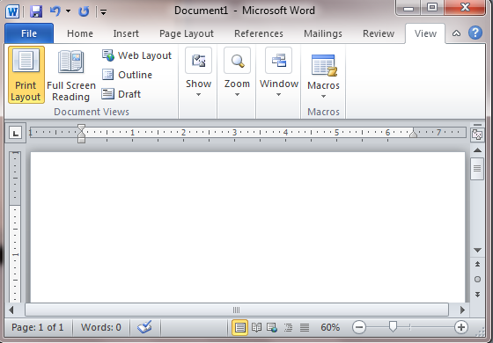
Graphical User Interface
Quick Access Toolbar
File Tab
Title Bar
Ribbon
Notes:
This lesson will introduce you to the Word window. You use this window to interact with Word. To begin this lesson, open Microsoft Word 2007. The Microsoft Word window appears and your screen looks similar to the one shown here.
- In the upper-left corner of the Word 2007 window is the Microsoft Office button. When you click the button, a menu appears. You can use the menu to create a new file, open an existing file, save a file, and perform many other tasks.
Next to the Microsoft Office button is the Quick Access toolbar. The Quick Access toolbar provides you with access to commands you frequently use. By default Save, Undo, and Redo appear on the Quick Access toolbar. You can use Save to save your file, Undo to rollback an action you have taken, and Redo to reapply an action you have rolled back.
Next to the Quick Access toolbar is the Title bar. The Title bar displays the title of the document on which you are currently working. Word names the first new document you open Document1. As you open additional new documents, Word names them sequentially. When you save your document, you assign the document a new name.
You use commands to tell Microsoft Word what to do. In Microsoft Word 2007, you use the Ribbon to issue commands. The Ribbon is located near the top of the screen, below the Quick Access toolbar. At the top of the Ribbon are several tabs;

Slide 4
Ribbon
Tabs
Buttons
Dialogue Box Launcher
Font Group
Notes:
clicking a tab displays several related command groups. Within each group are related command buttons. You click buttons to issue commands or to access menus and dialog boxes. You may also find a dialog box launcher in the bottom-right corner of a group. Clicking the dialog box launcher gives you access to additional commands via a dialog box

Slide 5
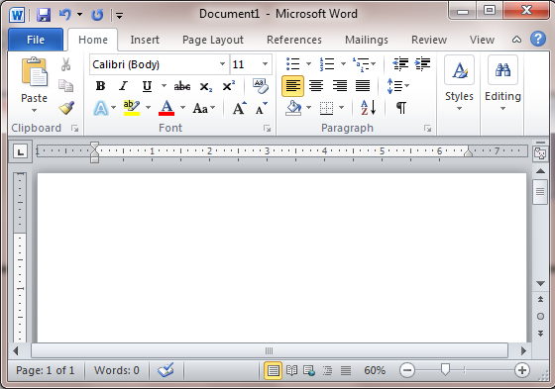
Text Area
Vertical Scroll Bar
Horizontal Scroll Bar
Zoom Bar

Slide 6
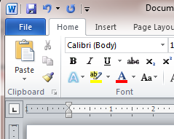
Undo & Redo
You can quickly reverse most commands you execute by using Undo. If you then change your mind again, and want to reapply a command, you can use Redo.
Undo
Redo
Example:
Click the Undo button on the Quick Access menu. The typing disappears.
Click the Redo button on the Quick Access menu. The typing reappears.

Slide 7
View
View
Draft
Draft View
Draft view is the most frequently used view. You use Draft view to quickly edit your document.
Web Layout
Web Layout view enables you to see your document as it would appear in a browser such as Internet Explorer.
Print Layout
The Print Layout view shows the document as it will look when it is printed.
Reading Layout
Reading Layout view formats your screen to make reading your document more comfortable.
Outline View
Outline view displays the document in outline form. You can display headings without the text. If you move a heading, the accompanying text moves with it.

Slide 8
Ruler
The Ruler is found below the Ribbon.
Tool for setting Tab Stops
Indent Markers
If your ruler is not visible:
Click the View Tab.
Click the check box next to Ruler in the Show/Hide group. The ruler appears below the Ribbon
1
2

Slide 9
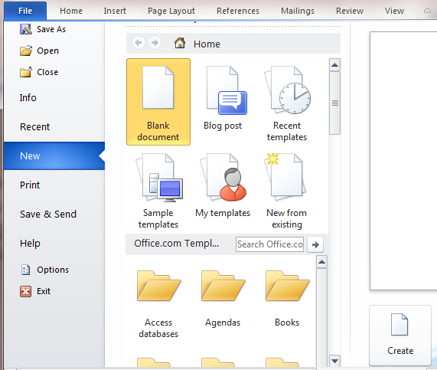
Creating a simple Document
Open MS Word 2010.
Click the File Tab.
Click New.
Choose a blank document, or choose from a template.
Click Create
1
3
2
4

Slide 10
Formatting a Paragraph
Place your cursor anywhere in the second paragraph of the sample text.
Choose the Page Layout tab. The default spacing appears in the Spacing Before field.
Click the up arrow next to the Spacing Before field to increase the space before the paragraph.
Click the up arrow next to the Spacing After field to increase the amount of space after the paragraph.

Slide 11
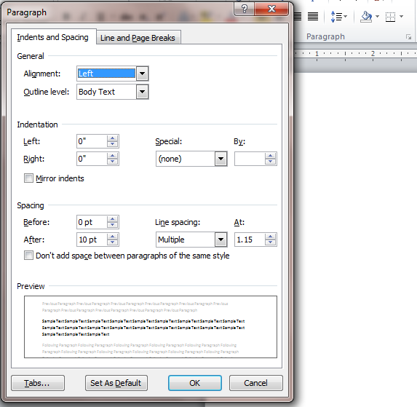
Line Spacing and Indentation
Click this button to open the Paragraph Dialog Box
Set the alignment of the text to Left, Right, Centered, or Justified
Special Indentation for the first line of the paragraph
Set the spacing between two lines of the same paragraph (i.e. 1.15 lines)

Slide 12
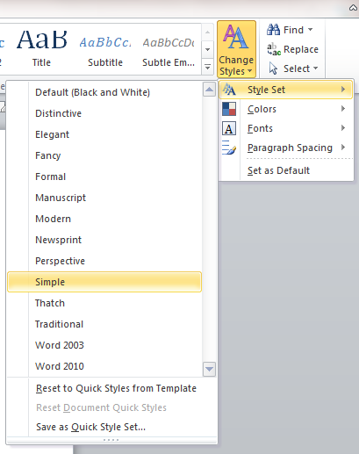
Choosing a Style Set
Choose the Home tab.
Click Change Styles in the Styles group. A menu appears.
Click Style Set. A menu appears. You can choose from any of the styles listed on the menu.
Click Simple (or any other Style Set). Word 2010 reformats all of the paragraphs into the Simple style.

Slide 13
Applying Styles

Slide 14
Creating a new style
Launch the Styles Dialog Box
Choose a style name
Adjust style format
Adjust Paragraph formatting and other options
Choose New Style

Slide 15
Inserting a picture Caption
2- Add a small description next to the caption
1- Right Click on a picture, and select Insert Caption
3- Click OK

Slide 16
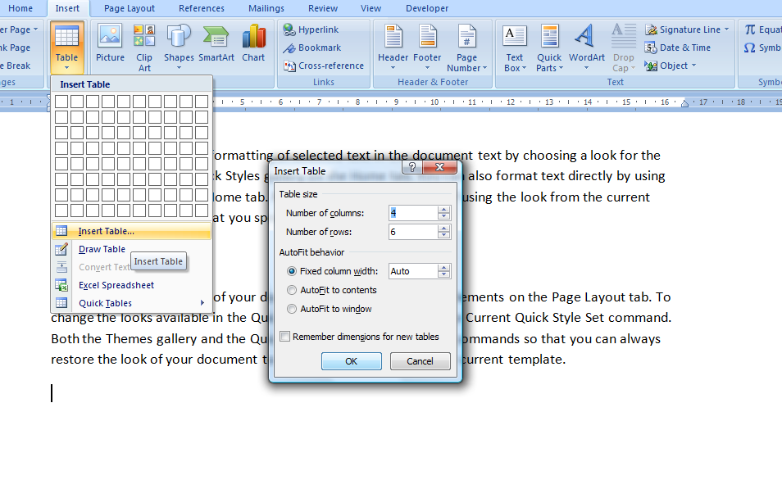
Creating a table
1- Choose Insert, Table
3- Choose the number of rows and columns
2- Click Insert Table
4- Click OK

Slide 17
Modifying table borders
2- Select Design, Borders
1- Select the part of the table that you want to modify
3- Add or Remove the borders of the table

Slide 18
Header and Footer
Double click on the Top of a page in the Print Layout view to add a page Header. (The header is usually common to all the pages in the same section)
Double click on the Bottom of a page in the Print Layout view to add a page Footer. (The footer is usually common to all the pages in the same section)

Slide 19
Inserting Page Numbers
1- Select Insert, Page Number
2- Choose the number format that you want

Slide 20
Formatting Page Numbers
1- Select Insert, Page Number
3- Choose the desired Number Format
2- Click on Format Page Numbers
4- Choose the first number in page numbering

Slide 21
Removing page numbering from the first page
2- Tick the box next to Different First Page
3- Now you are able to modify the Footer and the Header of the first page of the section separately
1- Double click on the page number in the header or in the footer

Slide 22
Columns
1- Select Page Layout, Columns
3- Choose the needed format
4- Choose the number of columns
2- Click on More Columns

Slide 23
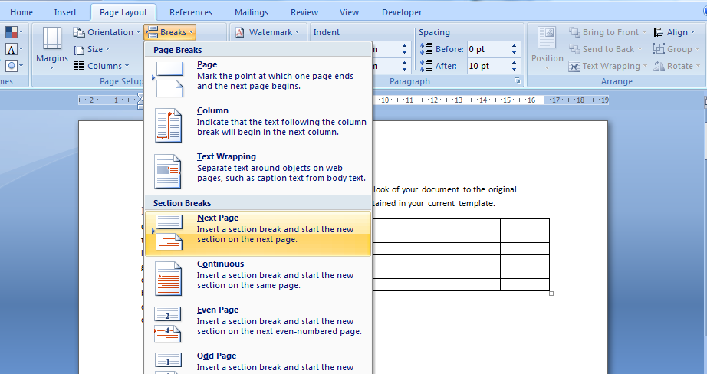
Section Breaks
•Use to divide one document into multiple parts, each one being independent from the others.
•This will allow:
Different Page Layout (Portrait/Landscape).
Different Page Numbering Scheme.
Different Page Headers/Footers.
1- Select Page Layout, Breaks
Note: A Page Break forces the following text to start on a new page, but the text remains in the same section
2- Select the desired Section Break

Slide 24
Section Breaks contd’
Links or unlinks sections

Slide 25
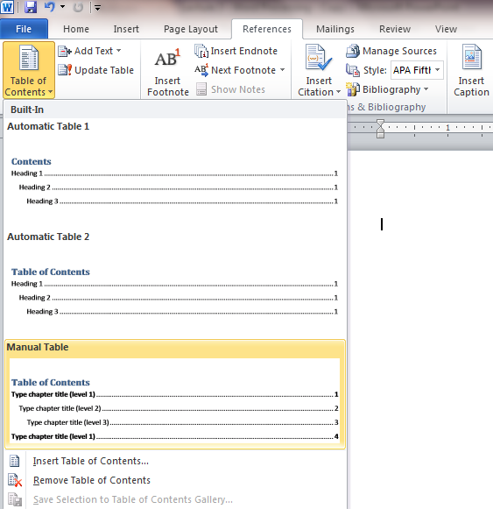
Inserting a Table of Contents
1- Select References, Table of Contents
Important Note!:
The table of contents will not work if you don’t use appropriate styles (i.e.: Heading1, Heading 2, and Heading 3…)
2- Select the desired format
Or choose Insert Table of Contents for advanced options

Slide 26
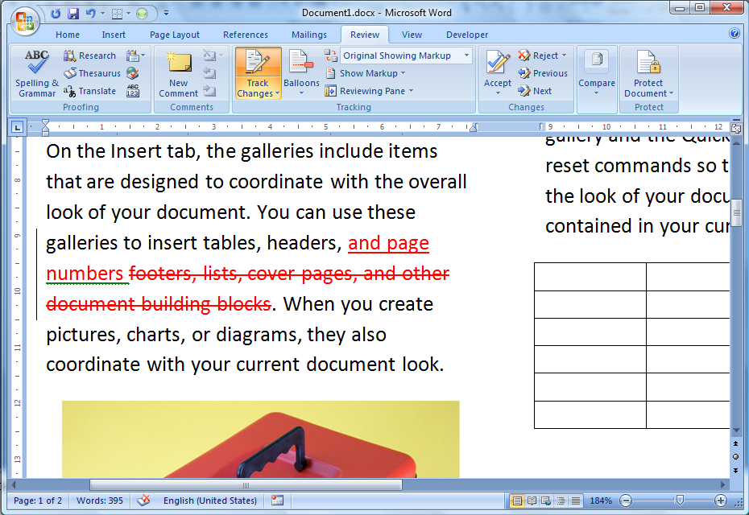
Tracking Changes
Track Changes is a way for Microsoft Word to keep track of the changes you make to a document. You can then choose to accept or reject those changes. (Useful when many people working on the same document)
1- Select Review, Track Changes
2- Text additions are tracked
3- Text deletions are also tracked

Slide 27
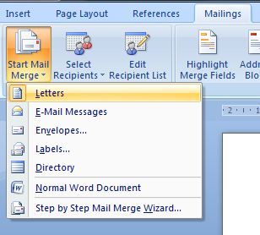
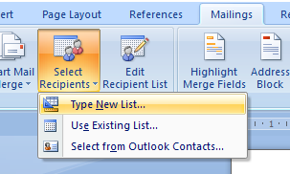
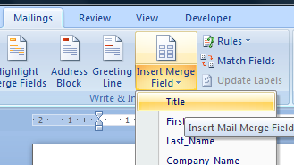
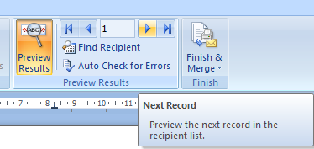
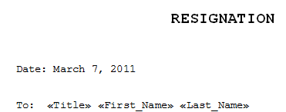
Mail Merging
Mail Merging is used when the same letter is to be sent to multiple recipients

Slide 28
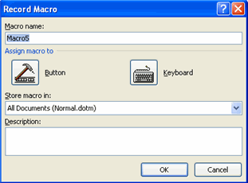
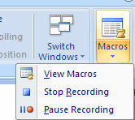
Macros
1- Select View, Macros, Record Macro
3- Execute the actions you want to record (i.e. writing a text, changing format…). These actions are being recorded
2- Choose a name for the macro. You can also assign a shortcut key
4- When you finish recording, press the Stop Recording Button

Slide 29
View and Modify the Macro
Joe

Slide 30
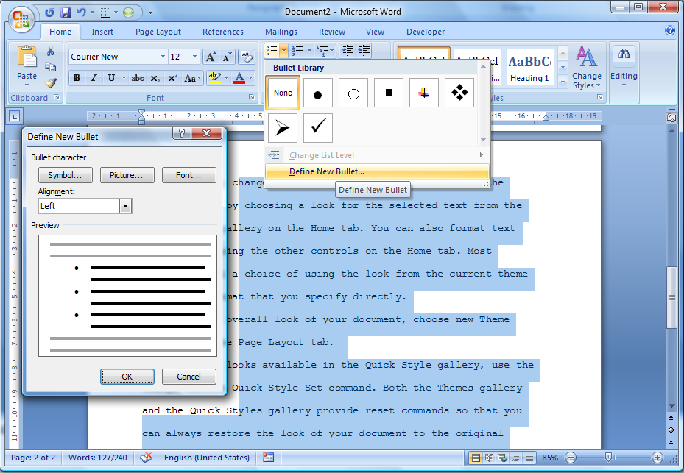
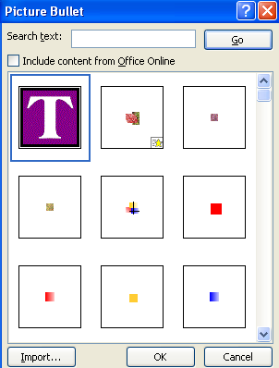
Personal Bullet Design
1- Select Home, Bullets
2- Click on Define New Bullet
4- Choose the bullet from an image file
3- Select the Picture option

Slide 31
Changing Margins and Orientation
1- Select Page Layout, Margins
2- Choose the desired margins
You can also change the orientation from portrait to landscape
You can also set each margin separately by using Custom Margins

Slide 32
Equations and Symbols
1- Select Insert, Equation
2- Select an equation
3- Select and replace the variables

Slide 33
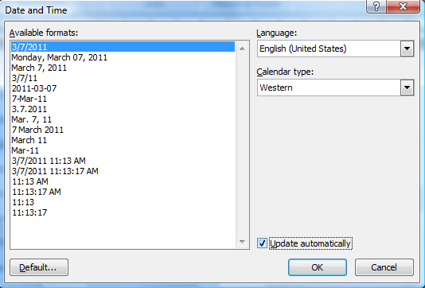
Automatic Updates
1- Select Insert, Date & Time
2- Choose the desired format, tick Update automatically, and then press OK

Slide 34
Citations and Bibliography

Slide 35
Citations and Bibliography (cont’d)

